Slide 1




National Coordination Centre
Pharmacovigilance Programme of India
Good Documentation Practices for AMCs &
Data management of ICSRs for NCC

Slide 2
Spontaneous adverse drug reaction (ADR) reporting is fundamental in the post marketing surveillances of medicine. It is important to capture information on ADR in a structured manner and to the highest possible quality standards to support accurate detection and analysis of drug safety signals.
With the recent move to electronic reporting, maintaining quality for electronic reports received from AMCs is a major challenge as reports are no longer subject to the regulator’s internal review or manual intervention. It is therefore essential that a common understanding and methodology for best practice in coding and data classification is implemented.
Introduction
National Coordination Centre
Pharmacovigilance Programme of India

Slide 3
Weapons for Collection of ADR data
For the collection of ADRs from across the country we have two different ways by which we can collect ADRs that are
1. Suspected Adverse Drug reporting form
2. Vigiflow Software
Data Collection at AMC level :
At AMCs level they used to fill suspected ADR forms. They collect ADR reports from different departments of a hospital and medical colleges and fill all that information in suspected ADR forms.
After that the information collected by suspected ADR of individuals (ICSRs) are uploaded in Vigiflow and send it to NCC for central assessment.
National Coordination Centre
Pharmacovigilance Programme of India

Slide 4
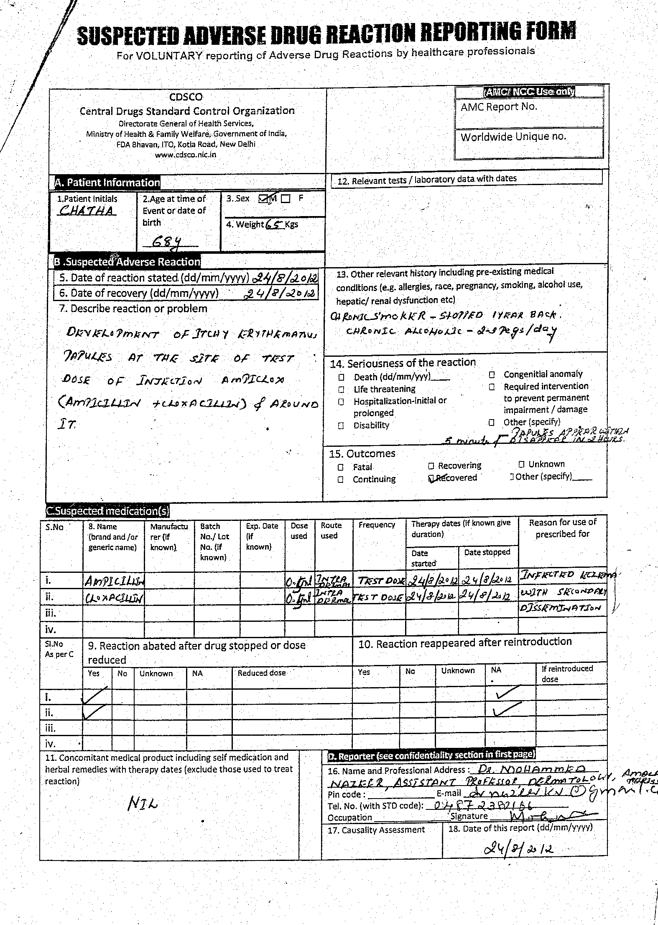
National Coordination Centre
Pharmacovigilance Programme of India

Slide 5

National Coordination Centre
Indian Pharmacopoeia Commission
Data Collection at NCC level :
NCC receives all ICSRs from different AMCs and the quality of reports checked from quality review panel by using completeness score.
NCC also prepares Monthly progress reports for each AMCs depending upon number of ICSRs received and Analysis report should be done for top 10 drugs with there top 10 SOCs in each month.
NCC resolving queries on suspected ADR or targeted ADR to stakeholders across the country.
NCC also commit quality ICSRs to WHO UMC.
National Coordination Centre
Pharmacovigilance Programme of India

Slide 6
Flow of Data Collection
Collection of data from peripheral centres in the form of Suspected ADR forms
Data collected from peripheral centres are sends to AMCs . The AMCs transforming these reports in e- reporting (E2B) by uploading into vigiflow and sends to NCC
All the ICSRs collected from different AMCs through vigiflow are checked for quality and committed of WHO-UMC
National Coordination Centre
Pharmacovigilance Programme of India

Slide 7
Why electronically data
We need to store our data electronically to manage it effectively.
Some of reasons for electronically data are:
Simplifies statistics
Scientific & administrative operations
Data retrieval
Data sharing
Back up and recovery
National Coordination Centre
Pharmacovigilance Programme of India

Slide 8
Data entry and sharing
Quality and correctness
Mandatory fields, error checks, logical checks….
User-friendliness
For ease of data entry but also in interpretation of interface, avoidance of ambiguous
messages
Confidentiality
What can be collected and what can later be shared
Timeliness
To keep internal deadlines and regulatory demands.
Sharing of Data
NCC share monthly progress reports to all AMCs across the country.
National Coordination Centre
Pharmacovigilance Programme of India

Slide 9
Analysis And Data Retrieval
We need tools to:
    Filter and sort data for analysis
    Data mining
    Drug/ ADR profile
    Line listings
    Retrieval of administrative data
    Quarterly and yearly statistics
    Performance
National Coordination Centre
Pharmacovigilance Programme of India

Slide 10
Data management through Vigibase:
For data management Vigiflow contains search and statistics part for committed
reports of all the AMCs.
In that search and statistic part, Data’s are available for all drugs that can be
search by the name of drugs or by date of committing or by report ID.
Search and statistic contains admin statistic part which shows total reports
committed per year.
For comparison of Indian data with global data Vigilyze is helpful.
National Coordination Centre
Pharmacovigilance Programme of India

Slide 11
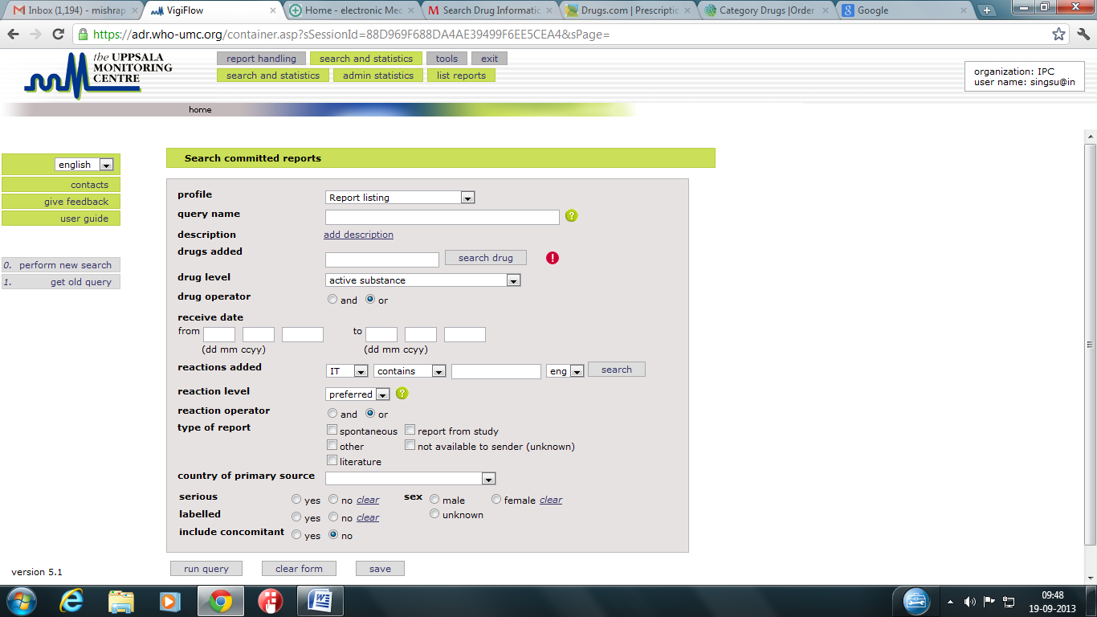
Search & statistics of Vigiflow
National Coordination Centre
Pharmacovigilance Programme of India

Slide 12
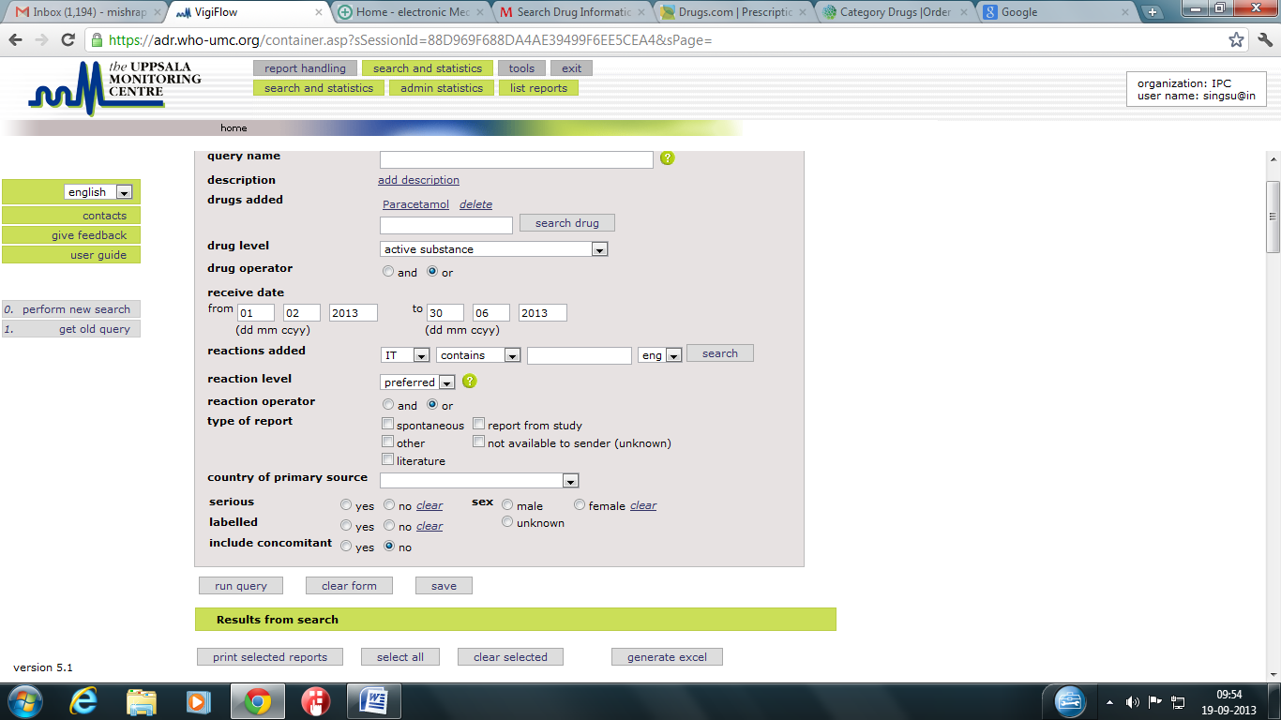
Drug & date Addition
National Coordination Centre
Pharmacovigilance Programme of India

Slide 13
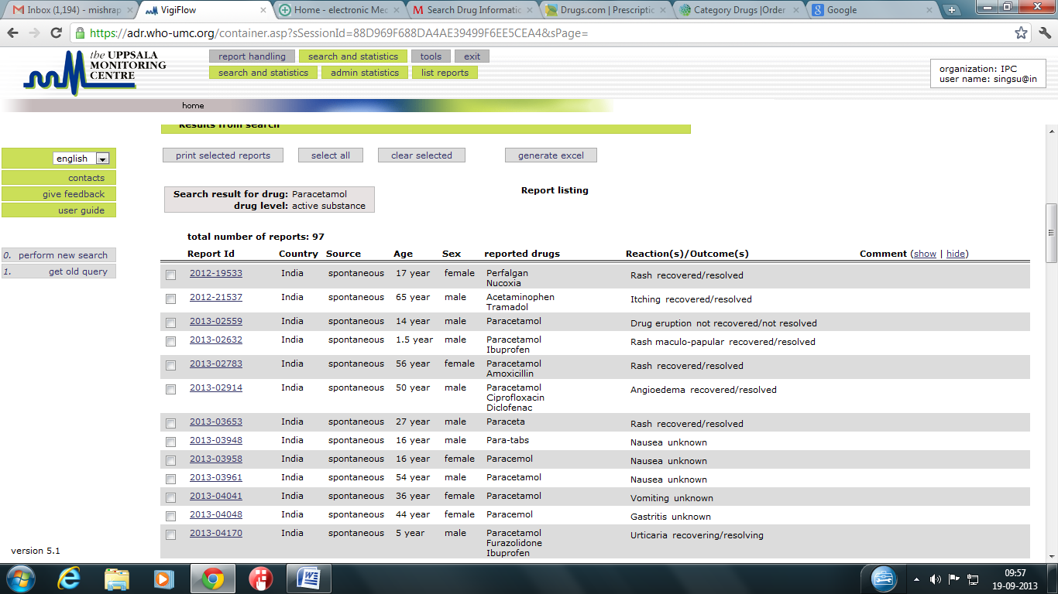
List of Committed Reports
National Coordination Centre
Pharmacovigilance Programme of India

Slide 14
Generate excel
After generating excel, four different parameters will appears which are as follow :
Query
Report listing
Drugs
Reaction
National Coordination Centre
Pharmacovigilance Programme of India

Slide 15
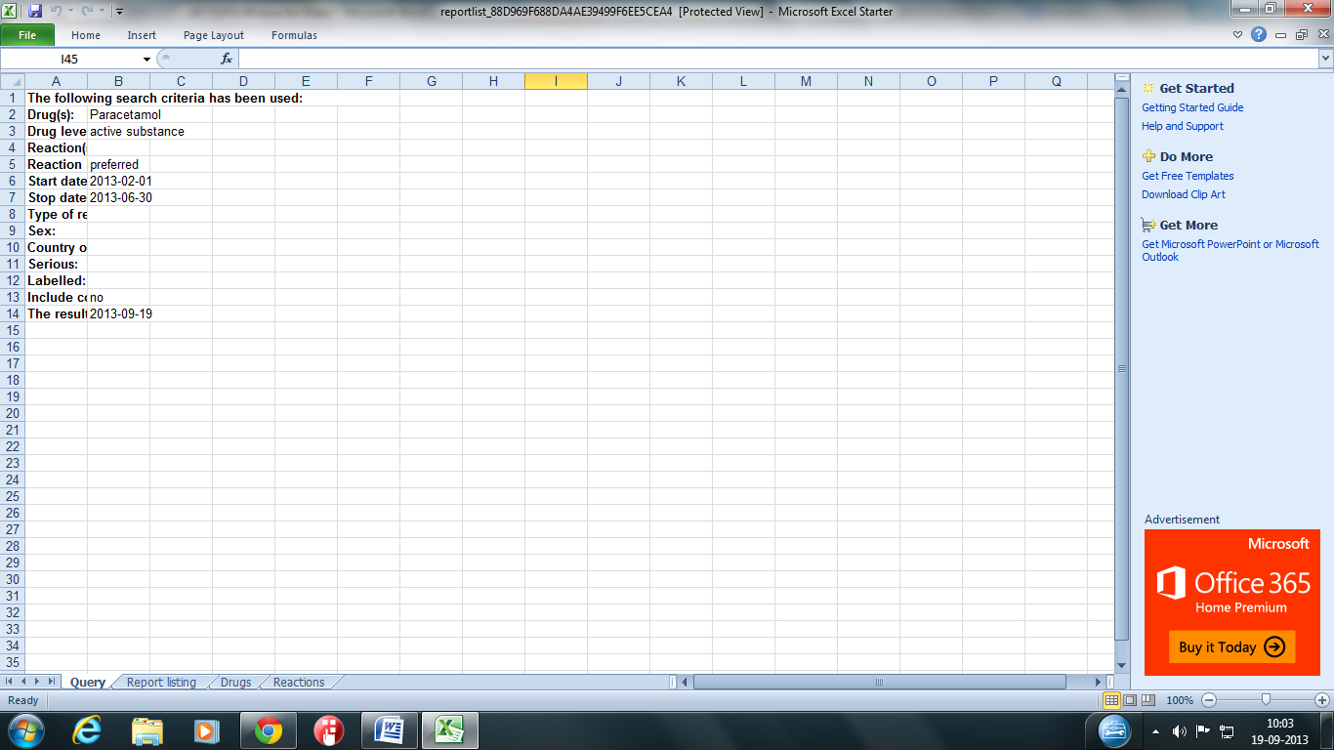
Query
National Coordination Centre
Pharmacovigilance Programme of India

Slide 16
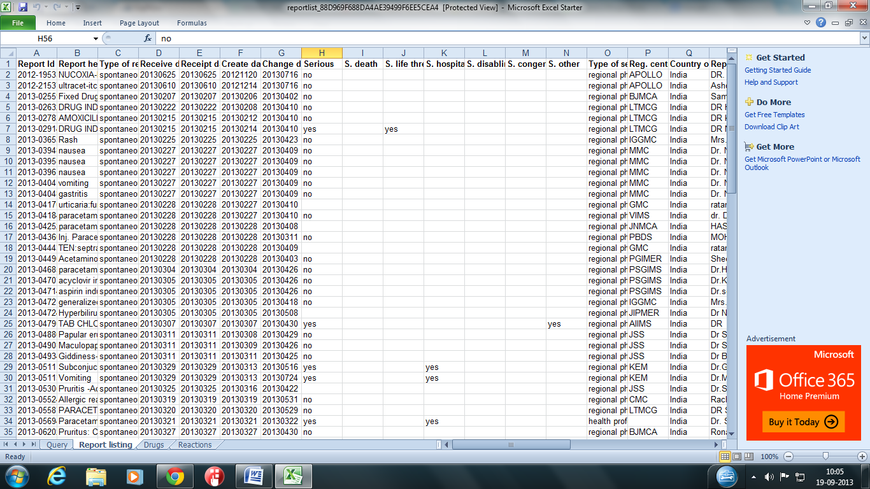
Report listing
National Coordination Centre
Pharmacovigilance Programme of India

Slide 17
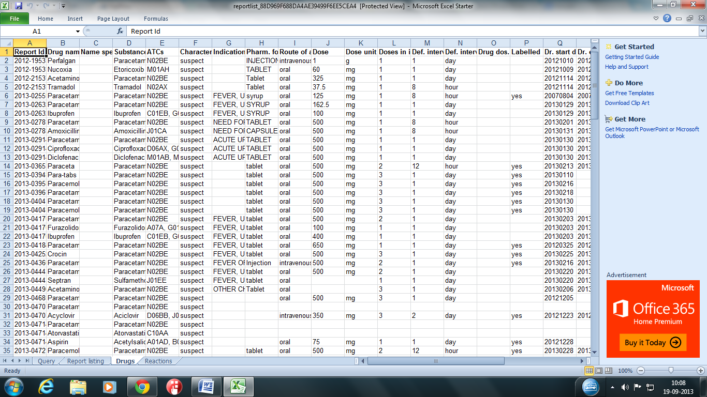
Drugs
National Coordination Centre
Pharmacovigilance Programme of India

Slide 18
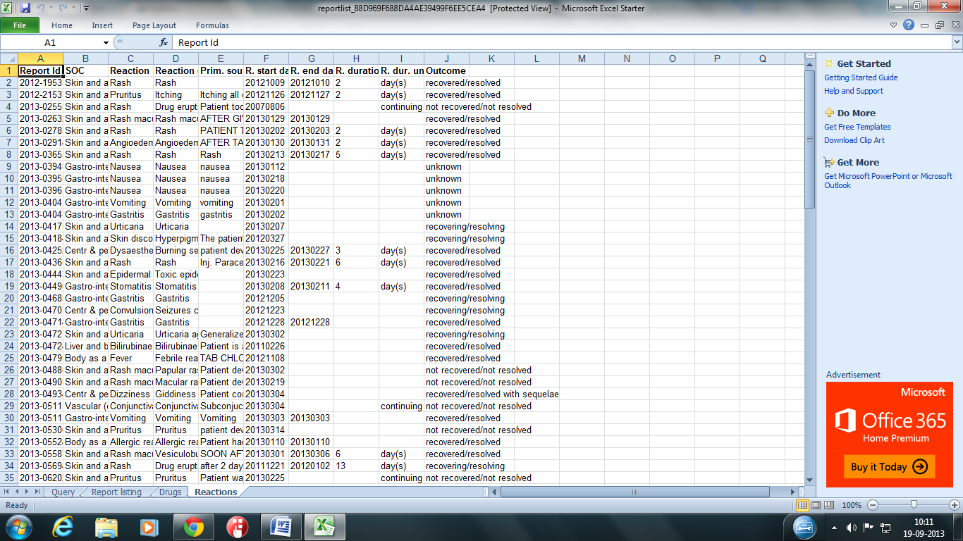
Reactions
National Coordination Centre
Pharmacovigilance Programme of India

Slide 19
Data Access and Protection
Only authorised users shall have access to the data and normally there is no need for different access levels.
User name and password or higher security demands.
Data should be encrypted when sent over for example the internet
Also important to consider when sending data to external receivers.
Traceability
You should be able to track changes via some kind of audit trail.
Also relevant for historical/deleted data.
National Coordination Centre
Pharmacovigilance Programme of India

Slide 20
Back up & Recovery
Protection of physical hardware / media
Servers
Back up media, disk or tapes
Physical separation of back up and data.
It is extremely important not only to back up data but also to test that the data can be restored from back up.
National Coordination Centre
Pharmacovigilance Programme of India

Slide 21


